Slide 1
Direct Simulation Monte Carlo Simulations of Ballute Aerothermodynamics Under Hypersonic Rarefied Conditions
James N. Moss, NASA Langley Research Center, Hampton, Virginia 23681-2199
Reviewed by: Nikita Persikov
Notes:
Conceptual entry descent and landing vehicle

Slide 2
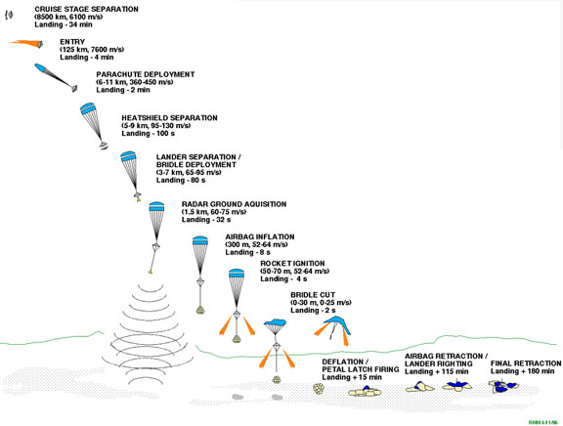
The Topic
Vehicles that enter the atmosphere of a planet move at orbital velocities
High velocity means high heating
Heating can be reduced by lowering velocity higher in the atmosphere

Slide 3

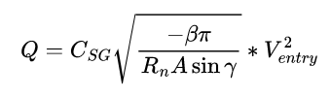


Governing Equations for EDL
Max heat rate
Total heat load
Knudsen Number
Mean Free Path
Notes:
Since density is lower higher up in the atmosphere, the entry vehicle experiences lower peak aerodynamic and heating loads.

Slide 4
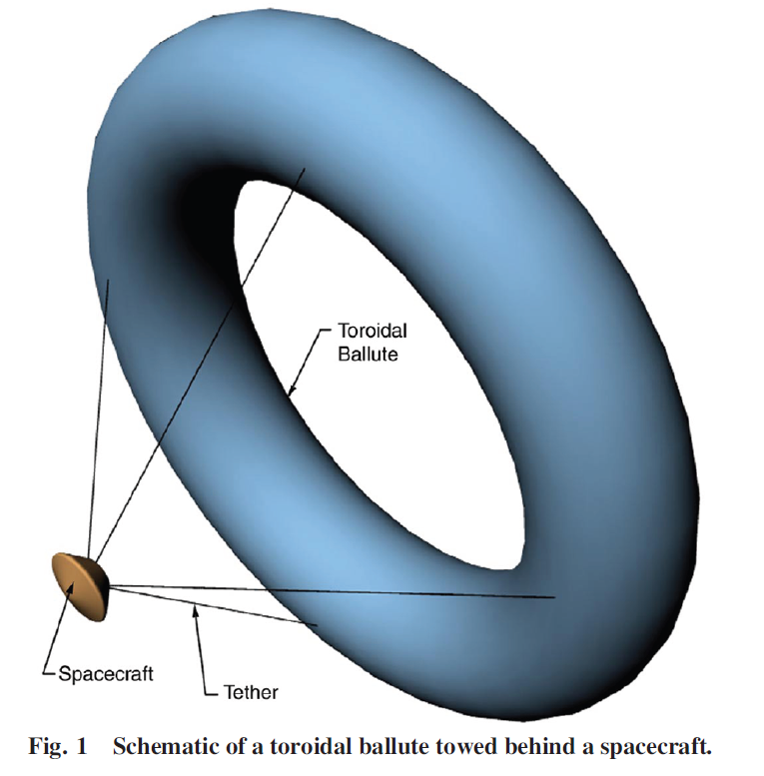
Aeroshell With Towed Ballute Concept
You can slow down sooner with a large surface area
One way to do that is to attach a deployable ballute to a regular aeroshell
Three main components to investigate:
Spacecraft/Aeroshell
Tethers
Toroidal Ballute
Notes:
A ballute is a balloon used as a parachute (hence, ball-ute)
This concept has not been tested before, possibly because such a large ballute (the reason for which will be explained later) is hard to pack, and such an experiment is expensive to carry out.
Theoretically, with a ballute, peak deceleration and heating occur higher up in the atmosphere.

Slide 5
Ballute Benefits
with a ballute, peak deceleration and heating occur higher up in the atmosphere.
Since density is lower higher up in the atmosphere, the entry vehicle experiences lower peak aerodynamic and heating loads.

Slide 6
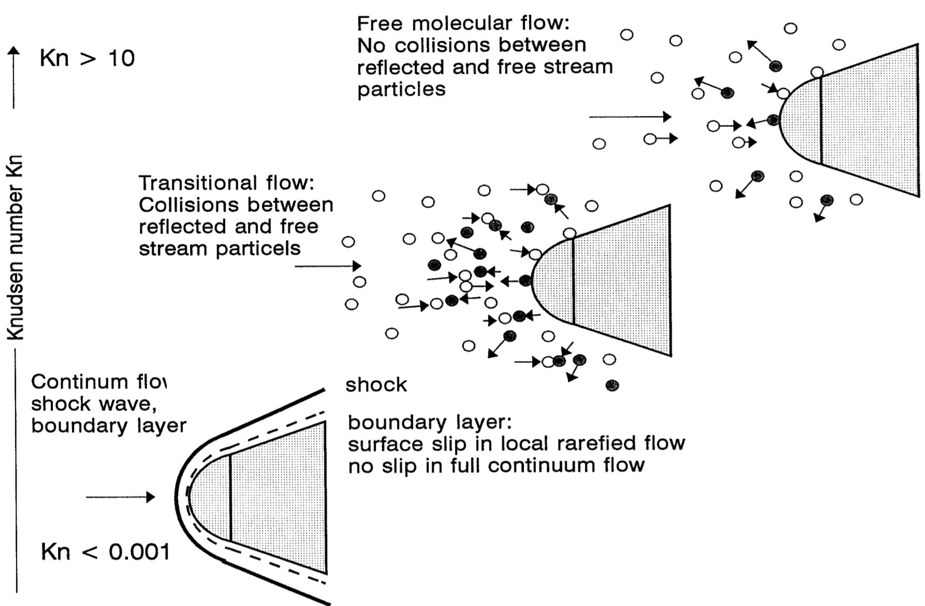
The Paper
This paper investigates the aerodynamics of an aeroshell with a towed ballute using DSMC
Since the flow higher up in the atmosphere is rarefied, a DSMC is preferred
Notes:
This paper investigates the aerodynamics of an EDL vehicle with a towed ballute. It simulates the performance of the ballute using direct simulation Monte Carlo method.
The motivation behind towed ballutes is that velocity is primarily reduced higher in the atmosphere during EDL when compared to conventional aeroshells.
Since the flow higher up in the atmosphere is rarefied, a DSMC is needed to determine how it will perform.
The paper calculates the surface (whatever that means) and the flowfield around a ballute with tethers, and another calculation determines the effect of a pathfinder-like capsule on the airflow that reaches the ballute.
Drag and heating coefficients as functions of rarefaction are also determined.
Shock interactions of the ballute in freestream and ballute with aeroshell are also presented.

Slide 7
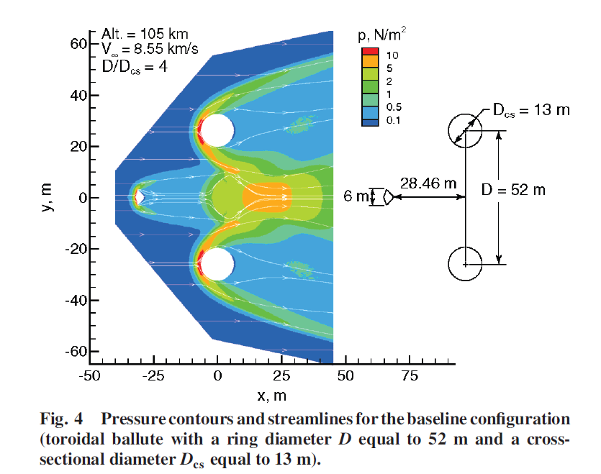
The Paper
What was simulated:
aeroshell, tethers, and ballute separately
aeroshell with ballute
All three combined
Drag and heating coefficients as functions of rarefaction were determined
Shock interactions of the ballute in freestream and ballute with aeroshell are also presented.

Slide 8
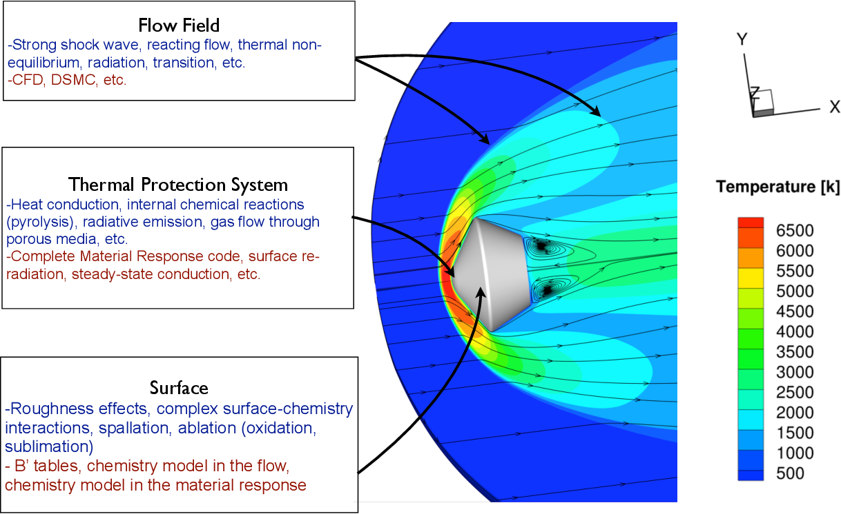
Complexity of EDL
To capture as many effects as possible, this project investigated:
Reacting chemistry
Nonequilibrium viscous effects
Effects that affect flow through shock interactions
Recirculation
Potential unsteady effects
Notes:
EDL vehicles experience many very different physical and chemical effects. These include chemical reactions, extreme heating, and the whole spectrum of flow regimes, among other things.

Slide 9
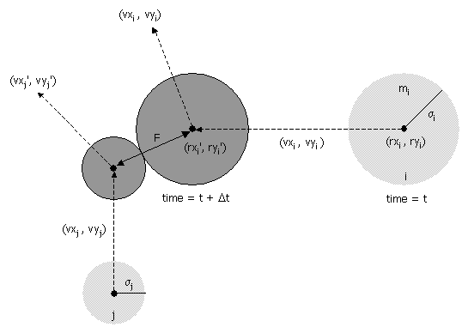
DSMC Concepts
Uses simulation molecules to represent real ones
Simulating collisions between all particles in a system would be highly inefficient
Only nearby particles can collide
Instead of checking all molecules against each other, groups of particles are randomly selected to either collide or not
Notes:
N_g is the number of groups to check
N_i is the number of particles of a species in a cell
w_mp is the weight of a simulation macroparticle
sigma is cross section
v_r is relative velocity
V is cell volume

Slide 10


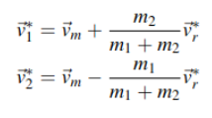
Governing Equations for DSMC
Collision probability is found using cross section and relative velocity product divided by the maximum value.
Velocities of molecules are found using momentum and energy conservation
Molecules collide if the P parameter is above some random value between [0,1)
Reflection angle can be determined using another random number.

Slide 11
DSMC Program Used: DS2V
The program can solve problems with:
Unsteady flow
Time averaged steady flow
Molecular collisions (variable hard sphere molecular model)
Energy exchange between kinetic and internal energies (Larsen–Borgnakke statistical model)
energy exchange between translational, rotational, and vibrational modes
Several studies have validated DS2V.
It was created by Graeme Austin Bird, who invented the DSMC method and was an authority on molecular gas dynamics

Slide 12
Assumptions
Non-catalytic surfaces
(At 105km altitude, significant atomic recombination is expected, which theoretically would heat the ballute more than the simulation predicts.)
Atmosphere consists of 5 species (accurate enough but not exactly true)
Exospheric temperature is 1200K (sometimes true)
Tethers are assumed to be in the freestream (mostly true)

Slide 13
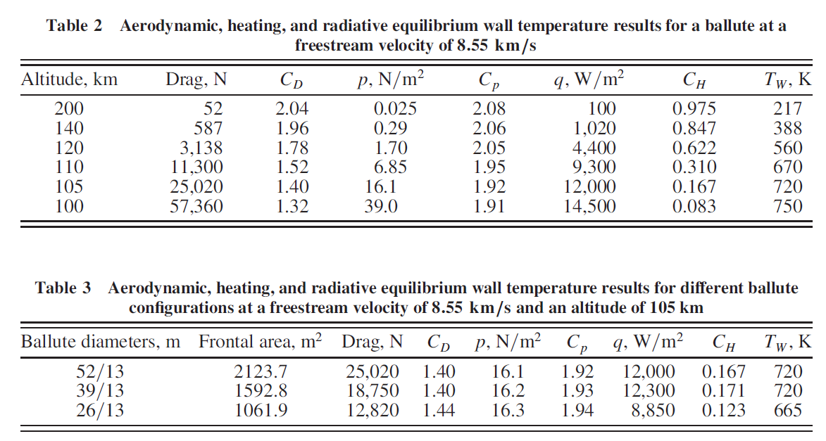
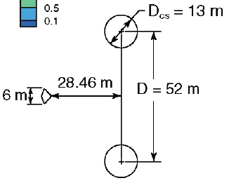
Results (Ballute Simulation)

Slide 14
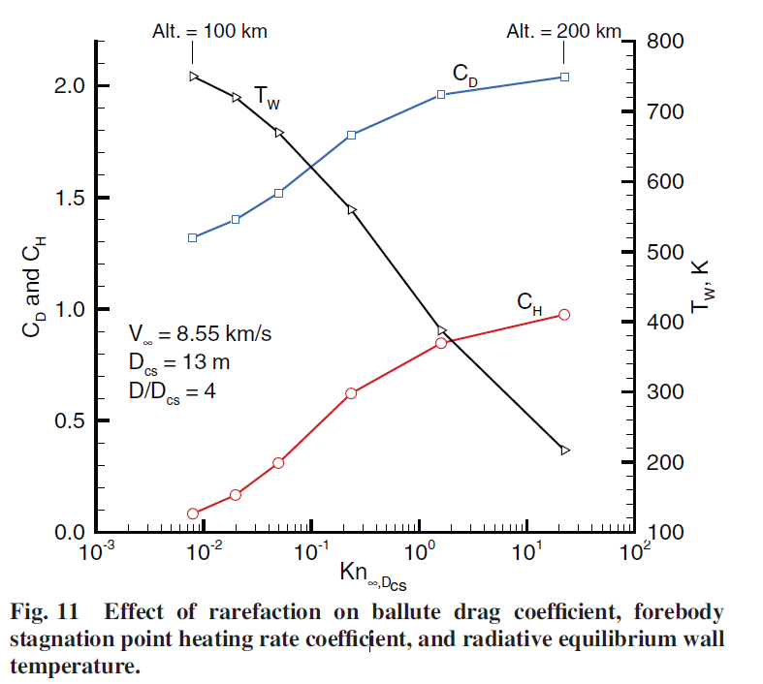
Results (Ballute Simulation)
They assumed a constant velocity
Sometimes accurate. The vehicle will experience a wide range of velocities during EDL
Notes:
Remember, they simulated a constant velocity flow, not a real EDL flight.

Slide 15
Result/Shortcoming (Capsule Simulation)
The DSMC predicts lower heating rate on the max capsule radius and heat magnitude on the aft body than the Navier-Stokes solution.
This may not be a good sign since two models disagree, but the DSMC may just be better suited for this type of physical situation

Slide 16
Results (Tether Simulation)
Since tethers are the smallest of the three main components of the EDL vehicle studied here, they experience the highest heating rates.
They were simulated using the 2D option in the DS2V program.
Could be a shortcoming, but since the tethers are not complex in geometry and are far from each other, the 2D assumption may not be a big deal

Slide 17
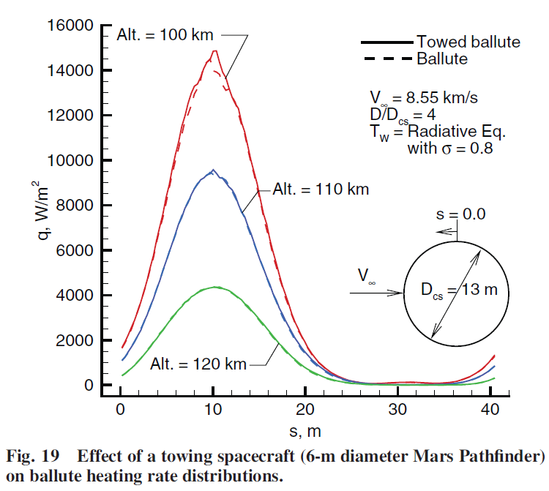
Result/Shortcoming (Ballute and Capsule)
This section tests the aeroshell with a towed ballute (no tethers)
The towed ballute results agree with the ballute-only results. This is because the wake of the aeroshell passes through the hole in the ballute.

Slide 18
Results/Shortcomings (All Three)
In this case, a configuration where the aeroshell’s wake would impact the ballute was considered, to see the effects of an unsteady flow situation.
They attempted to get time-averaged heating rates for the ballute in this case.
Because the flow was very unsteady, DS2V would remove certain results if the number of molecules in the simulation fluctuated by more than some (unspecified) number of standard deviations.
My interpretation: the sim needs to add molecules if the flow is complicated. Too much variation in molecules -> not an accurate comparison -> not a useful time-averaged result.

Slide 19
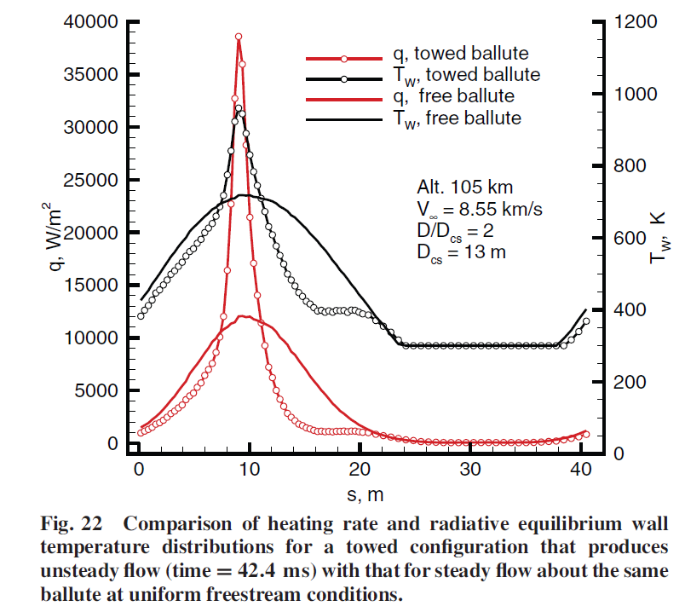
Results/Shortcomings (All Three)
Towed ballute configuration selected so that the spacecraft shock hit the ballute produced shock–shock interactions which resulted in adverse aerothermodynamic loads for both the ballute and the aft end of the spacecraft.
In other words: you want to avoid configurations where the spacecraft shock hits the ballute.

Slide 20
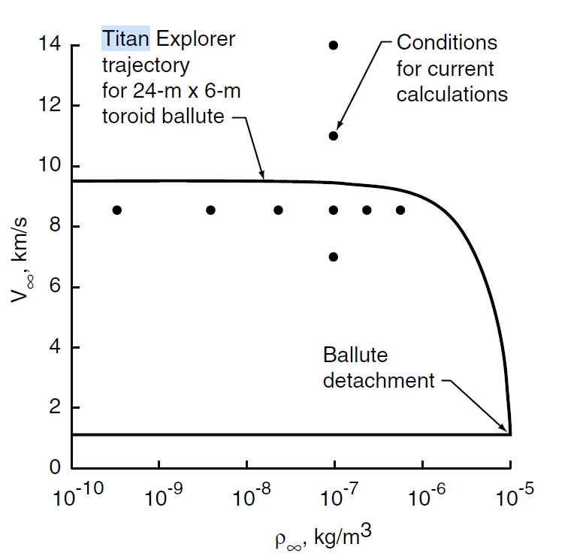
Comparing to Another Study
The time history of the velocity in this investigation is compared to that of a Titan ballute aerocapture study
Some relation is visible

Slide 21
Summary of Shortcomings
2D version of the DSMC simulation was used throughout the investigation
Non-catalytic surfaces assumed, meaning calculated heat loads are underestimates
5 species atmosphere assumed (they did not specify which ones)
Not a big deal if they used the 5 most common ones for each atmospheric layer
Tethers assumed to be in freestream (not entirely true)
All three components configuration with no shock/shock interactions was not considered
No experimental verification

